Slide 1
Foundation high school program + Endorsement
Graduation requirements
And
Endorsement options

Slide 2
General information
Students are expected to complete the Foundation High School Program with endorsement.
Students may also earn Distinguished Level of Achievement by including and successfully completing Algebra II in their selected coursework.
Students will be asked to choose a career goal and an endorsement in the 8th grade.
Students will be allowed to change their endorsement choices in high school if they choose.

Slide 3
What is an endorsement?
A personalized learning plan consists of a related series of courses in line with a student’s career interests and goals.

Slide 4
FHsP+Endorsement - Course requirements
The following courses are required for students to graduate.

Slide 5
FHSP +Endorsement - Course requirements:
English - 4 credits
English I, II, III & IV
Mathematics - 3 credits + 1 additional math credit
Algebra I, Geometry + 2 additional math courses
Science - 3 credits + 1 additional science credit
Biology, IPC/Chemistry Or Physics + 2 additional science courses
Social Studies - 3 credits
World Geography or World History
US History
Government (½) and Economics (½)

Slide 6
FHSP +Endorsement - Course requirements:
Languages other than English (Foreign Language) - 2 credits in the same language.
Physical Education - 1 credit
Health - ½ credit
PACE (Personal, Academic, and Career Exploration) - ½ credit
Fine Art - 1 credit
Electives - 6 credits
FHSP + Endorsement = 26 credits
* Students planning to take athletics and an elective all 4 years of high school should plan accordingly and try to earn some high school credits in middle school (ex: foreign language).

Slide 7
5 Endorsements
STEM (Science, Technology, Engineering, Math)
Business & Industry
Public Services
Arts & Humanities
Multidisciplinary Studies

Slide 8
STEM
The STEM endorsement must include:
Algebra II
Chemistry, and
Physics
The STEM endorsement options include:
Computer Science (4 computer science courses)
Engineering
Math (5 math credits with 2 advanced math courses which Algebra II is a prerequisite)
Science (5 science credits including Biology, Chemistry, and Physics)

Slide 9
Business & Industry
The Business & Industry endorsement includes courses from the following career clusters:
Agriculture, Food and Natural Resources
Architecture and Construction
Arts, Audio/Video Technology & Communication
Business, Marketing, & Finance
Hospitality & Tourism
Information Technology
Manufacturing
Transportation, Distribution, & Logistics
Also includes English courses: advanced journalism, newspaper/yearbook, debate.

Slide 10
Public services
The Public Services endorsement includes courses from the following career clusters:
Education & Training
Health Science
Human Services
4 years of AFJROTC

Slide 11
Arts & Humanities
An Arts & Humanities endorsement includes courses focusing on the following options:
Social Studies
Languages other than English
Fine Arts

Slide 12
Multidisciplinary studies
A Multidisciplinary Studies endorsement includes
4 courses from each content area (4x4):
English, Math, Science, Social Studies
Earn credits in a variety of advanced courses from multiple content areas.

Slide 13
What classes can my student take at watkins that will count as a high school credit??
Notes:
These courses that I’m about to go over are already attached to the packet you picked up.

Slide 14
7th Grade HS Credit courses
Principles of Applied Engineering (1 credit)
Principles of Human Services (1 credit)
Spanish I (1 credit)
Spanish I for Native Speakers (1 credit)
French (1 Credit)
Touch System Data Entry (Keyboarding) (½ credit)
Professional Communications (½ credit)
6th to 7th Grade Registration is DUE FEBRUARY 15th

Slide 15
8th Grade HS Credit courses
Principles of Manufacturing (1 credit)
Principles of Applied Engineering (1 credit)
Principles of Architecture (1 credit)
Principles of Human Services (1 credit)
Principles of Hospitality & Tourism (1 credit)
Principles of Information Technology (1 credit)
Principles of Business, Marketing & Finance (1 credit)
Business Information Management 1 (1 credit)
Spanish I or II OR Spanish I NS (1 credit)
Spanish II/III for Native Speakers (2 credits)
French I or French II (1 credit)
Art 1 (1 credit)
Touch System Data Entry (Keyboarding) (½ credit)
Professional Communications (½ credit)
7th to 8th Grade Registration is Due on February 15th

Slide 16
Beginning to understand paying for college
College & Career
Cypress Fairbanks ISD

Slide 17
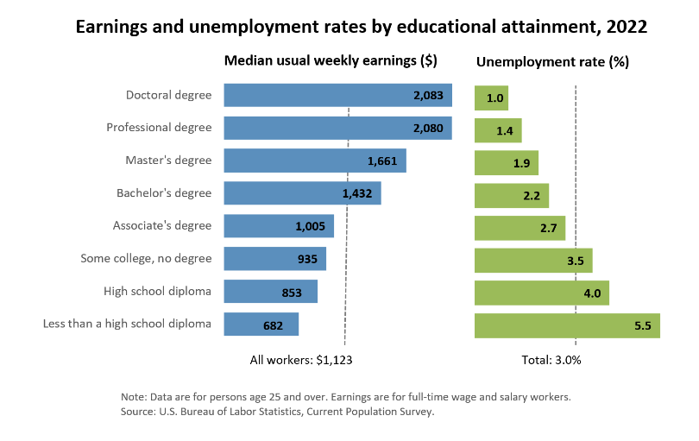
Why go to college or career training?
The more you learn, The more you earn...
https://www.bls.gov/emp/chart-unemployment-earnings-education.htm

Slide 18
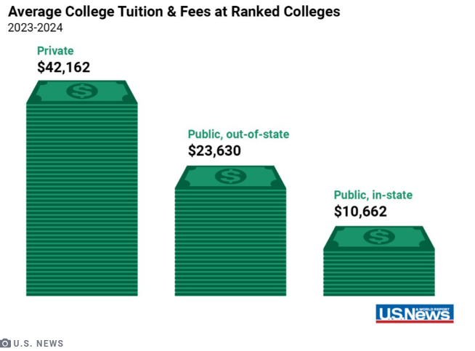
Paying for college
Have you ever thought about how you will pay for college??
https://www.usnews.com/education/best-colleges/paying-for-college/articles/paying-for-college-infographic

Slide 19
What do students pay for in college & Career Programs?
Item | Description
Tuition | The cost of taking courses. Courses’ costs vary by school.
Room and board | Housing/Lodging and food costs vary by school.
Books and school supplies | Books can be expensive. School supplies may include: Book bags Notebooks Pens and pencils Paper and computer paper Desk accessories such as folders, trays, and pen holders
Fees | Fees depend upon you school. Schools can provide a list of fees. Examples include activity fees, lab fees, parking fees, etc.
Equipment & Room Materials | This category might include: A computer and printer Reading lamps A microwave, a refrigerator, etc. Sheets, towels, etc.
Travel and miscellaneous expenses | If you commute to school, include transportation costs. If you live on campus, include travel during school breaks. You may also want to include clothing and mobile phone costs.

Slide 20
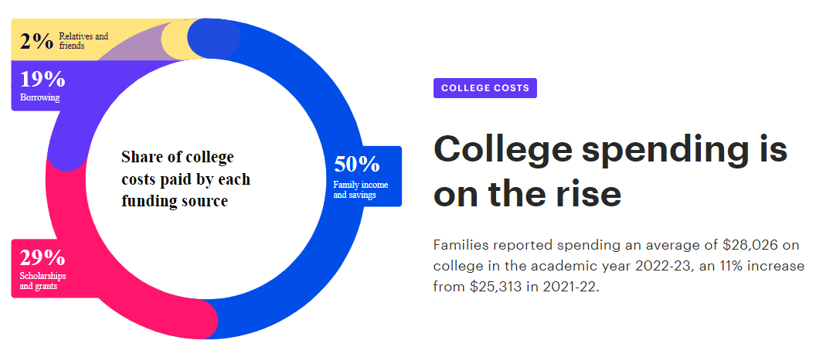
Breakdown of how most families pay for college
https://www.salliemae.com/about/leading-research/how-america-pays-for-college/

Slide 21
What is financial aid?? Money to help students pay for college & career training

Slide 22
83.8% of college students benefit from some form of financial aid.
Texas ranks 2nd in total student financial aid dollars
According to Educationdata.org

Slide 23
Types of financial aid
Scholarships
Scholarships are awards given to students by the University or independent organizations in recognition of merit and/or need.
Grants
State or Federal money given to students who meet a designated criteria. Typically based upon FAFSA application.
Work Study
Program that enables students to work part time to help finance their educational costs.
Student Loans
Money borrowed by students and/or their parents to pay for school. This amount will have to be paid back to the lender with interest.

Slide 24
Scholarship - What is it? How do I get one?
Money that is awarded to a student based upon merit (an ability, skill, or talent) and/or financial need. Scholarships do NOT have to be paid back = FREE MONEY!!
Student Characteristics
Gender Race Religion Family/Medical history Employer First Generation
Merit
Academics Artistic Athletic Ability Test Scores Community Service
Income
Awarded to promising students based upon family income.
Bottomline to receive a scholarship:
You have to EARN IT: Be SCHOLARSHIP WORTHY!

Slide 25
tHE ROAD TO SCHOLARSHIPS
Middle School
Practice good study skills, begin establishing goals, get involved in something you love, start taking high school level courses.
11th Grade
Made a list of interested college/career programs, continue to make the highest grades possible, take the SAT/ACT, stay committed.
9th & 10th Grade
Take advanced (K/AP/DC) classes, earn A’s and establish a strong GPA, explore career interests, develop unique interests.
12th Grade
Finalize SAT/ACT scores, apply to college, complete scholarship applications (as many as possible), complete the FAFSA.

Slide 26
It’s never too early to learn about financial aid
Understand options
Know how to prepare
Apply on time
Know the types of financial aid available and how to apply for each one.
Take action and set yourself up to receive the maximum amount of money to help pay for college and career programs.
Do not miss deadlines or timelines for financial assistance. Money is first come, first serve!

Slide 27
You can go! Make a plan and be prepared!
Middle School – Strong organizational/study skills & get involved.
Grades 9-11 - Build a scholarship worthy profile.
Grade 12 - Complete Scholarship application and FAFSA (financial aid) application.

Slide 28
Thanks for coming!

